Slide 1
Lecture 10: file systems
Prof Yotov
CS6233
Slides by Prof Sandoval
Some slides derived from : William Stallings, Tanenbaum/Bo, and Brendan Dolan-Gavitt
Thanks !!

Slide 2
This lecture
Files
Directories
File System Implementation
Example File System(s)

Slide 3
Files and Filesystems
Computers need persistent storage
Want data to last after process terminates or computer is shut down
Multiple programs may need to access the same data – e.g., read a file written by someone else

Slide 4
Disk Access
We saw already how a disk driver is implemented
We could imagine exposing a simple interface based on the low-level IDE interface:
Read from block k
Write to block k
What are some problems with this?
Notes:
Coordination problems
Partitioning scheme on the disk

Slide 5
Files
Given that providing direct access to disk blocks is unacceptable, we need some abstraction
A file is that abstraction – a logical unit of data that is backed by multiple underlying blocks on disk
In some ways, this is like having an address space for memory, except the underlying resource is a disk

Slide 6
Naming
We need some way of referring to the data in a file, i.e. a name
File names typically have some set of allowed characters that varies depending on the OS and filesystem
For example, * is allowed in Linux filenames, but not in Windows
OS X allows emoji 👍💯🔥
Other differences: name length limits (255 on most Linux filesystems, 8.3 in DOS), case sensitivity

Slide 7
Filesystem
Typically when we say filesystem we refer to the on-disk layout and data structures used to represent files
Many filesystems invented over the years:
FAT16/FAT32 – used by DOS/Windows
NTFS – used by Windows NT and later
HFS+ – used by OS X
ext2/3/4, reiserfs, btrfs, ... – Linux
ISO9660 – used for CDs/DVDs

Slide 8
Structure of Files
In most OSes, the content of a file on disk is stored as just an unstructured bunch of bytes
Any structure is specific to the application
However, some operating systems have structured files:
Fixed size blocks (records)
Key-value storage

Slide 9
Identifying File Types
An OS may need some way of identifying the type of a file so that it can be opened by the correct application
One way to do this is by giving different types of files different extensions – .mp3, .jpg, etc.
Another way is to look at the first few bytes and guess based on a magic number
Yet another way is to store information in some filesystem metadata
A final way (used on Linux) is to not try to guess and make the user explicitly specify the program

Slide 10
Guessing with Magic
Simple idea in principle – may file types can be identified by looking at the first few bytes
JPEG files start with 0xFF 0xD8
DOS/Windows executables start with "MZ" (0x4D 0x5A)
Boot sector ends with 0x55 0xAA
Linux & OS X come with a utility called "file" that uses a database of such signatures to identify file types
But not all file types can be identified this way, and the identification is not always unambiguous

Slide 11
"Openoffice Can't Print on Tuesdays"
In 2008, some people started reporting that the word processor OpenOffice would randomly fail to print
"When I click print I get nothing." -Tuesday, August 5, 2008
"I downloaded those updates and Open Office Still prints." -Friday, August 8, 2008
"Open Office stopped printing today." -Tuesday, August 12, 2008
"I just updated and still print." -Monday, August 18, 2008
"I stand corrected, after a boot cycle Open Office failed to print." -Tuesday, August 19, 2008

Slide 12
What Happened?
Printing in OpenOffice converts the file to PostScript and includes the date:
Then the printing daemon reads the file, checks to make sure it's a valid PostScript file using the file command, and prints it
file had a bug – if "Tue" appeared at the right position in the file, it would be misidentified as a particular database.
%!PS-Adobe-3.0
%%Creator: (OpenOffice.org 2.4)
%%For: (steve)
%%CreationDate: (Tue Mar 3 19:47:42 2009)

Slide 13
File Associations as Metadata
This strategy is used by OS X
HFS+ has a notion of resource forks – a hidden set of metadata stored in the filesystem
You can set a specific file to be opened by a particular application, and that information will be saved in the resource fork
If no resource fork exists, OS X falls back to using the file extension

Slide 14
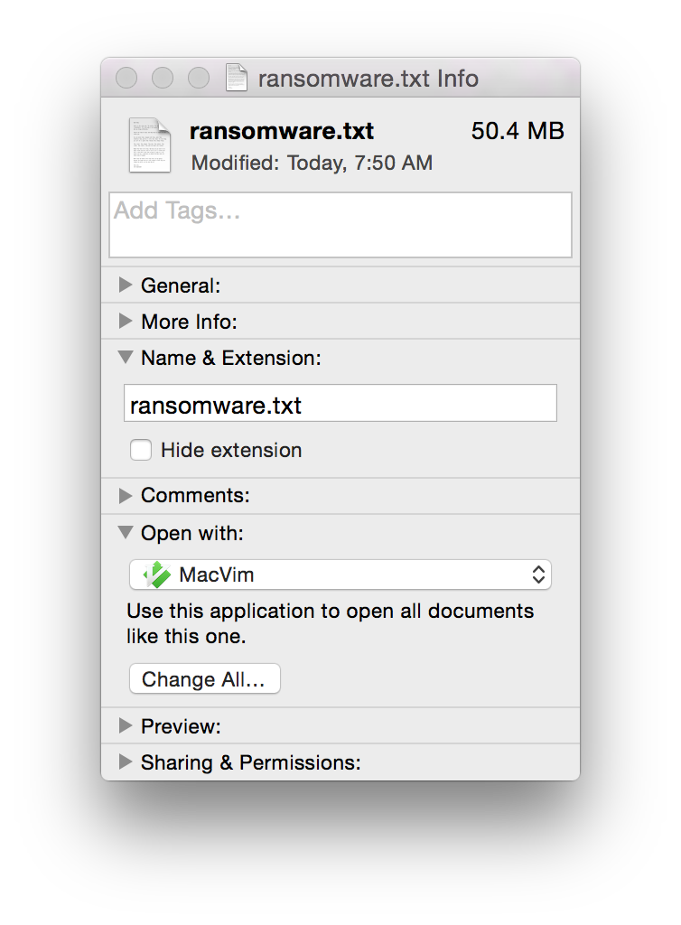

Slide 15
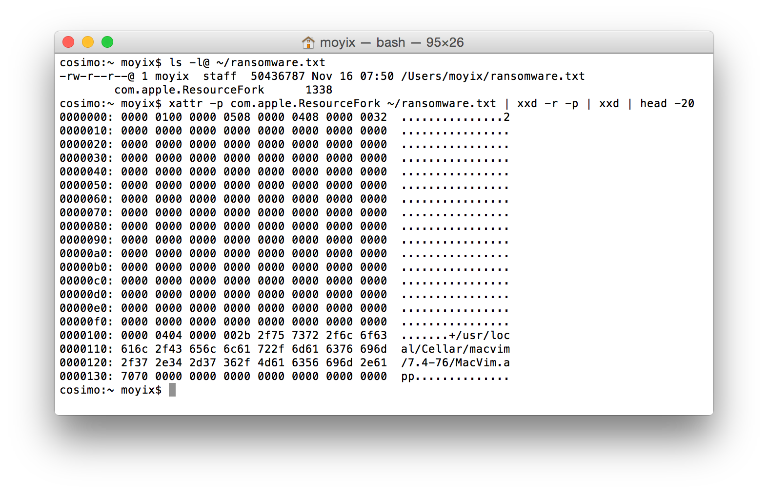

Slide 16
File Attributes
Aside from associations, filesystems can keep many other kinds of metadata about a file
Permissions
Creator/owner
Hidden
Locked
Timestamps
File Size

Slide 17
Side Note: Timestamps
Timestamps on files are stored as filesystem metadata
Even regular users can modify the timestamps on files they create!
They can't be relied on to prove a file was created at a particular time (demo)

Slide 18
File Operations
Create
Delete
Open
Close
Read
Write
Append
Seek
Get attributes
Set attributes
Rename

Slide 19
This lecture
Files
Directories
File System Implementation
Example File System(s)

Slide 20
Directories
Directories are filesystem entries that store lists of filesx
Simplest filesystems have no hierarchy – all files are kept in one top-level directory
Most filesystems now are hierarchical – form a tree structure
Note: a system might have multiple filesystem trees
E.g., Windows has one tree for each drive (C:, D:, etc.)
(Why does it start at C?)

Slide 21
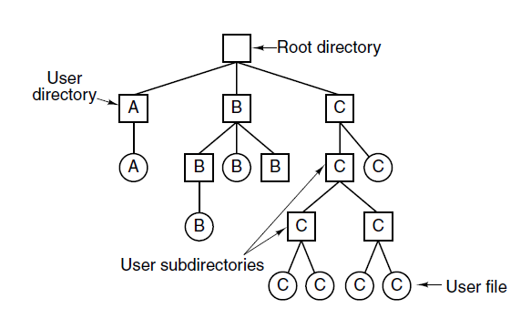
Hierarchical Directory Systems
A hierarchical directory system.

Slide 22
Paths
To specify a file, you specify a path through the filesystem tree
Each directory in a path is delimited by a path separator which varies between OSes
C:\Users\Gustavo\Desktop\homework.txt
/Users/Gustavo /Desktop/homework.txt
Users>Gustavo >Desktop>homework.txt

Slide 23
Relative Paths
We saw that one of the pieces of information stored in a process data structure is the current working directory
This allows us to specify files without giving their full path, e.g. if working directory is /home/gustavo :
cp a.txt b.txt
cp /home/gustavo/a.txt /home/gustavob.txt
Most OSes also support two special path components: "." and ".." for "current directory" and "parent directory"
/home/gustavo/../a.txt = /home/a.txt

Slide 24
Working Directory
What happens if a library function needs to change the working directory?
For example, perhaps it needs to call another command that assumes files are in the current directory
If it doesn't change the working directory back before returning, the rest of the program may write files into the wrong place
Library functions that modify the working directory are also not thread safe, because the working directory is shard by all threads in a process

Slide 25
Directory Operations
Create
Delete
Opendir
Closedir
Readdir
Rename
Link
Unlink

Slide 26
Special Files
Some OSes have special files, which do not correspond to data on disk
We have already seen device files, which let you treat hardware devices as simple files
These need to be identified specially somehow
In UNIX, filesystem metadata is used to distinguish
DOS just had special names – AUX, CON, LPT1

Slide 27
DOS Devices
Name Function
---- --------
CON Keyboard and display
PRN System list device, usually a parallel port
AUX Auxiliary device, usually a serial port
CLOCK$ System real-time clock
NUL Bit-bucket device
A:-Z: Drive letters
COM1 First serial communications port
LPT1 First parallel printer port
LPT2 Second parallel printer port
LPT3 Third parallel printer port
COM2 Second serial communications port
COM3 Third serial communications port
COM4 Fourth serial communications port

Slide 28
Mounting
On systems with a unified directory hierarchy (UNIX-like OSes), we may want to connect multiple filesystems together
This is done by mounting a filesystem
Attaches the new filesystem hierarchy at an existing (empty) directory
In Linux/OS X, this is done with the mount command

Slide 29
Questions
How is this all implemented?!
How do we make it fast? (Buffering, Caching)
How do we make it reliable?
How does xv6's filesystem work?

Slide 30
This lecture
Files
Directories
File System Implementation
Example File System(s)

Slide 31
Filesystem Layout on Disk
A filesystem is defined by the layout of data on disk and the algorithms used to store and retrieve that data
A typical disk layout consists of
A master boot record that contains code for booting the system
Multiple partitions, each with their own boot block
Within a partition, the actual filesystem data, usually beginning with a superblock that has key filesystem parameters

Slide 32
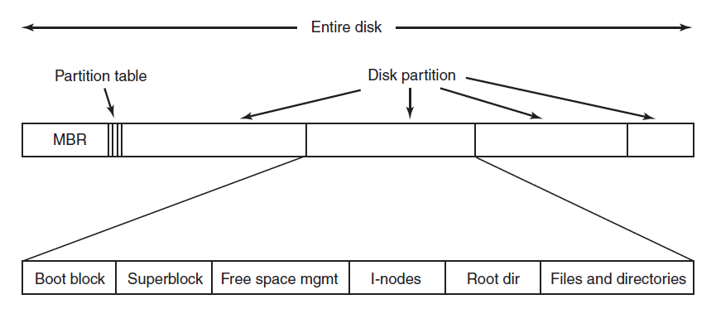
File System Layout
A possible file system layout.

Slide 33
Example Superblock (xv6)
struct superblock {
uint size; // Size of file system image (blocks)
uint nblocks; // Number of data blocks
uint ninodes; // Number of inodes.
uint nlog; // Number of log blocks
uint logstart; // Block number of first log block
uint inodestart; // Block number of first inode block
uint bmapstart; // Block number of first free map block
};

Slide 34
Implementing Files
One of the most important things to decide in a filesystem is how to map between files and disk blocks
Possible implementations:
Contiguous allocation
Linked list (on-disk or in-memory)
I-nodes

Slide 35
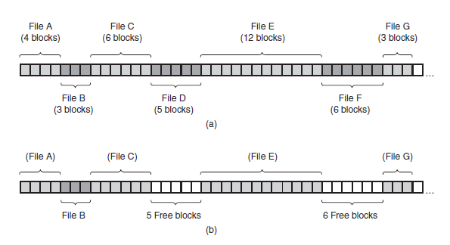
Contiguous Layout
(a) Contiguous allocation of disk space for seven files. (b) The state of the disk after files D and F have been removed.

Slide 36
Contiguous Layout

Slide 37
Contiguous layout
Advantages
Easy to implement
Excellent Read performance
Disadvantages
Fragmentation

Slide 38
Contiguous Allocation
Despite these disadvantages, contiguous allocation is still used in CDs and DVDs (ISO9660 and UDF)
Since these are written all at once and don't get updated over time, we avoid fragmentation
Size of every file is known ahead of time

Slide 39
Linked List Allocation
Inside each file block, keep a pointer to the next block in the file
No issues with fragmentation & wasted space

Slide 40
Linked List Allocation

Slide 41
Linked List Allocation
Storing a linked list on disk has performance issues though:
To read disk block n, we need to read n-1 blocks before it
Entire block can no longer be used for data (we need space for the next pointer), so reads of file block must span two physical blocks

Slide 42
Linked List Allocation (In-Memory)
Improvement: keep a table in memory with just the pointer information
Each entry corresponds to a physical block and contains the pointer to the next block
This is called a File Allocation Table (FAT) and is how the FAT16/FAT32 filesystem works

Slide 43
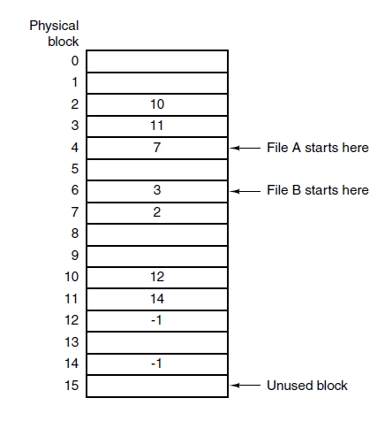
File allocation table (FAT)
Linked list allocation using a file allocation table in main memory.

Slide 44
Disadvantages of FAT
FAT is, well, fat – if you have a large disk, it takes up a lot of space in memory
Suppose we have a 1TB disk, 1KB blocks:
(1 TB / 1 KB) entries * (4 bytes / entry) = 4GB for FAT
For 32GB disk with FAT32 (4KB blocks):
(32GB / 4KB) entries * (4 bytes / entry) = 32MB

Slide 45
I-Nodes
A more compact way is to give each file a small data structure that lists its blocks, called an i-node (index node)
Now we only need to store in memory an amount of data proportional to the number of open files
Amount of storage needed to store the mapping grows with the number of files, not the total size of the disk

Slide 46
I-Nodes

Slide 47
Implementing Directories
To actually open a file, we supply a path, which gives a list of directories and a filename
A directory must have some on-disk representation that stores the list of filenames, attributes, and pointer to the file data
Basically needs to implement the map filename => file data

Slide 48
Directory Design Decisions
How is the file data located using the directory entry?
Usually determined by how files are represented
E.g., with i-nodes you just store a pointer to the i-node
How should we store the file attributes?
How should we store filenames?

Slide 49
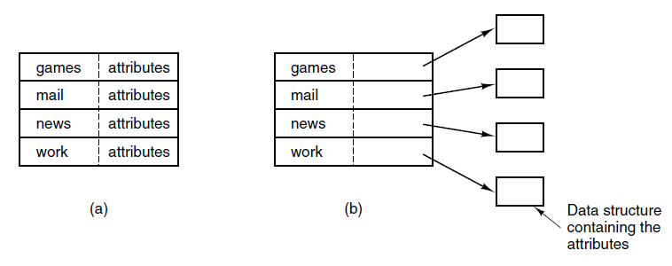
Attribute Storage
(a) A simple directory containing fixed-size entries with the disk addresses and attributes in the directory entry.
(b) A directory in which each entry just refers to an i-node.

Slide 50
Filename Storage
Simplest: just pick a maximum filename length and always store
But if we want to allow long names, this is really wasteful
Some other options:
Make each file entry structure in a directory variable-length
Put all filenames at the end of the directory entry and store pointers to them in each file entry

Slide 51
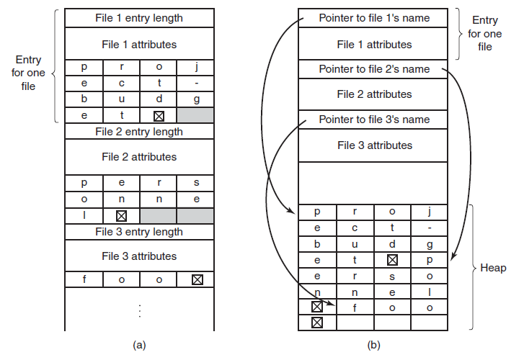
Implementing Directories (2)
Two ways of handling long file names in a directory. (a) In-line. (b) In a heap.

Slide 52
Hard and Symbolic Links
Sometimes it's convenient to have multiple names for the same file
E.g., have a file shared by making it accessible from multiple users' home directories
How can we do this in terms of directory entries?

Slide 53
Hard and Symbolic Links
Hard link: just have each directory store a pointer to the same file information; e.g., each directory entry just points to the same i-node
Symbolic link (symlink): create a new directory entry type, which stores the path to the link target
Note: in UNIX systems, hard links can be created with ln, symlinks can be created with ln -s

Slide 54
Hard/Symlink Comparison
Hard links can only point to files on the same filesystem (why?)
With hard links, we must keep a count of how many links to the file exist – otherwise we won't know when we can delete a file
Symbolic links have extra overhead – we have to store a full path to the target file

Slide 55
Linking Pitfalls
Since you now can have multiple names for the same file, you have to be careful not to duplicate data when copying
With symbolic links, you can also create links to directories
This means you can create loops in the filesystem!
Most standard utilities detect this, but some applications might not

Slide 56
Write Performance Issues
Most disks now have fast caches that make reads fast
Writing is still slow – and worse because typical workload consists of many small writes
To write a file, you need to write to the directory entry, i-node, and finally file data
Overhead dominates: the actual write may take only 50 microseconds, but requires:
10ms to seek (move the read arm into the right position)
4ms for disk platters to rotate into the right position

Slide 57
Log-Structured Filesystem
To solve this, Rosenblum and Ousterhout (1992) created the log-structured filesystem
Basic idea - structure the disk as one big log

Slide 58
Log-Structured Filesystem
Buffer writes in memory, periodically flush them out in one contiguous segment at the end of the log
At the start of the segment, place information about where to find i-nodes and file data within the current log segment
Finally, maintain a map that says which log segment the i-nodes for files/directories can be found

Slide 59
Log-Structured Filesystem
If we overwrite data in a file, or if we delete it, we will waste space (and eventually run out of space)
To solve this, a cleaner thread constantly runs, removing unused entries from the back of the log and placing old but still-in-use entries at the front

Slide 60
Log-Structured Filesystem
Structuring as a log also provides crash recovery
If the OS crashes or we lose power in a traditional filesystem, we may leave things in an inconsistent state
For example: wrote file data, but didn't update the directory entry
LFS solves this by keeping a checkpoint, which tracks what the most recent consistent filesystem state is
After a crash, we can either just revert to the last checkpoint, or revert and then replay as many log entries as possible (while keeping the filesystem consistent

Slide 61
Journaling Filesystems
LFS is a major change to how filesystems work and hasn't been widely adopted
However, one of its key ideas – using a log to provide recovery in the case of a crash – has been incorporated into modern filesystems
These are called journaling filesystems
NTFS, HFS+, and ext3 all support journaling
ReiserFS was the first Linux FS to support journaling

Slide 62
Crashes and Inconsistency
As mentioned, crashes can lead to inconsistent filesystem states
For example, consider operations to delete a file
Remove the file from the directory entry
Mark the i-node as free
Mark the file data blocks as free
What happens if we do some of these and not the others?

Slide 63
Idempotence
Because the operations listed in the journal log entry could be carried out more than once, they must be idempotent (doing it twice is the same as doing it once)
For example, marking a block as free in a bitmap is idempotent
Adding a block to a list of free blocks is not idempotent
But we can make it idempotent by adding a check to make sure it's not already in the list

Slide 64
Keeping Track of Free Space
To write new data to a disk, we need to find some place to put it
You may recall from memory management two strategies from tracking free space:
Store a list somewhere (possibly in the free space)
Keep a bitmap of free blocks

Slide 65
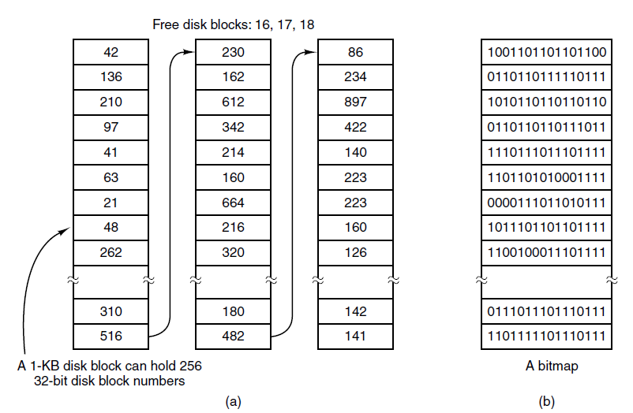
Free Space

Slide 66
This lecture
Files
Directories
File System Implementation
Example File System(s)

Slide 67
xv6 FS Design
On-disk data structures to represent tree of files & directories
Crash recovery (never end up with inconsistent fs)
Concurrent access by multiple files
Provide caching, since disks are slow

Slide 68
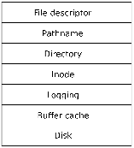
xv6 FS
The filesystem is one of the most complex parts of xv6
Organized into seven layers:
We've seen these already

Slide 69
FS Layers
Disk layer reads and writes blocks on the IDE drive
Buffer cache layer caches blocks and synchronizes access to them
Logging layer wraps multiple operations in a single atomic transaction, providing crash recovery
i-node layer represents files as we saw last time
The directory layer contains a special type of i-node that gives a list of names and i-node pointers
The pathname layer resolves paths to i-nodes
The file descriptor layer provides an abstraction for accessing several kinds of object (pipes, files, devices) as files

Slide 70

The xv6 Superblock
struct superblock {
uint size; // Size of file system image (blocks)
uint nblocks; // Number of data blocks
uint ninodes; // Number of inodes.
uint nlog; // Number of log blocks
uint logstart; // Block number of first log block
uint inodestart; // Block number of first inode block
uint bmapstart; // Block number of first free map block
};

Slide 71
The Buffer Cache
Two goals:
Synchronize access to blocks so that two processes don't try to access the same data simultaneously
Cache commonly used blocks so that we don't have to read from the disk all the time
Implemented in bio.c

Slide 72
High-Level Interface
When you want to read from a block, call bread() with the block number
After modifying the data, call bwrite() to write it to disk
When you're done with a block, call brelse() to release it

Slide 73
Buffer Cache Structure
struct buf {
int flags;
uint dev;
uint blockno;
struct buf *prev; // LRU cache list
struct buf *next;
struct buf *qnext; // disk queue
uchar data[BSIZE];
};
#define B_BUSY 0x1 // buffer is locked by some process
#define B_VALID 0x2 // buffer has been read from disk
#define B_DIRTY 0x4 // buffer needs to be written to disk
struct {
struct spinlock lock;
struct buf buf[NBUF];
// Linked list of all buffers, through prev/next.
// head.next is most recently used.
struct buf head;
} bcache;
Linked list used for IDE queue

Slide 74
Buffer Read/Write
// Return a B_BUSY buf with the contents of the indicated block.
struct buf*
bread(uint dev, uint blockno)
{
struct buf *b;
b = bget(dev, blockno);
if(!(b->flags & B_VALID)) {
iderw(b);
}
return b;
}
// Write b's contents to disk. Must be B_BUSY.
void
bwrite(struct buf *b)
{
if((b->flags & B_BUSY) == 0)
panic("bwrite");
b->flags |= B_DIRTY;
iderw(b);
}
Notes:
Iderw puts in the queue of pending operations

Slide 75
Buffer Cache Synchronization
Calling bread() attempts to get the block either from cache or by reading the disk
It acquires a lock on the buffer cache, then tries to find a cached copy
If the cached copy is found and not in use, it sets a flag (B_BUSY) on it, releases the lock, and returns
If it is in use, it calls sleep() to wait until the block is free

Slide 76
Buffer Cache Synchronization
// Look through buffer cache for block on device dev.
// If not found, allocate a buffer.
// In either case, return B_BUSY buffer.
static struct buf*
bget(uint dev, uint blockno)
{
struct buf *b;
acquire(&bcache.lock);
loop:
// Is the block already cached?
for(b = bcache.head.next; b != &bcache.head; b = b->next){
if(b->dev == dev && b->blockno == blockno){
if(!(b->flags & B_BUSY)){
b->flags |= B_BUSY;
release(&bcache.lock);
return b;
}
sleep(b, &bcache.lock);
goto loop;
}
}
Access to cache protected by lock
Sleep if block is found but busy

Slide 77
Buffer Cache Synchronization
// Not cached; recycle some non-busy and clean buffer.
// "clean" because B_DIRTY and !B_BUSY means log.c
// hasn't yet committed the changes to the buffer.
for(b = bcache.head.prev; b != &bcache.head; b = b->prev){
if((b->flags & B_BUSY) == 0 && (b->flags & B_DIRTY) == 0){
b->dev = dev;
b->blockno = blockno;
b->flags = B_BUSY;
release(&bcache.lock);
return b;
}
}
panic("bget: no buffers");
}
Note: this is only safe because we already know there is no buf with this blockno
If not found in cache, just pick any non-busy buffer

Slide 78
Buffer Cache Synchronization
// Not cached; recycle some non-busy and clean buffer.
// "clean" because B_DIRTY and !B_BUSY means log.c
// hasn't yet committed the changes to the buffer.
for(b = bcache.head.prev; b != &bcache.head; b = b->prev){
if((b->flags & B_BUSY) == 0 && (b->flags & B_DIRTY) == 0){
b->dev = dev;
b->blockno = blockno;
b->flags = B_BUSY;
release(&bcache.lock);
return b;
}
}
panic("bget: no buffers");
}
Note: clears B_VALID and B_DIRTY
If not found in cache, just pick any non-busy buffer

Slide 79
Buffer Caching
To actually cache frequently used blocks, xv6 maintains an LRU cache
Implemented as a doubly linked list (prev and next pointers in the struct buf)
After releasing a block, we move it to the head of the list so it can be found quickly

Slide 80
LRU
// Look through buffer cache for block on device dev.
// If not found, allocate a buffer.
// In either case, return B_BUSY buffer.
static struct buf*
bget(uint dev, uint blockno)
{
[...]
// Is the block already cached?
for(b = bcache.head.next; b != &bcache.head; b = b->next){
[...]
}
// Not cached; recycle some non-busy and clean buffer.
// "clean" because B_DIRTY and !B_BUSY means log.c
// hasn't yet committed the changes to the buffer.
for(b = bcache.head.prev; b != &bcache.head; b = b->prev){
[...]
}
Search for cached block starts at the head
Search for free block starts at the tail

Slide 81
Not covered

Slide 82
Releasing a Buffer
// Release a B_BUSY buffer.
// Move to the head of the MRU list.
void
brelse(struct buf *b)
{
if((b->flags & B_BUSY) == 0)
panic("brelse");
acquire(&bcache.lock);
b->next->prev = b->prev;
b->prev->next = b->next;
b->next = bcache.head.next;
b->prev = &bcache.head;
bcache.head.next->prev = b;
bcache.head.next = b;
b->flags &= ~B_BUSY;
wakeup(b);
release(&bcache.lock);
}
Wake up anyone waiting on the buffer

Slide 83
Logging Layer
Operations on the filesystem often require multiple writes to disk
Crashes may leave things in an inconsistent state, e.g. during deletion:
May end up with directory entry pointing to a freed block (bad!)
May end up with a block that is not marked free but not referenced (harmless but wasteful)
Logging layer allows higher layers to group multiple writes into a single transaction that will be committed atomically

Slide 84
Logging
Instead of performing modifications to the disk directly, system calls in xv6 write out a log of pending operations to the disk
Each log entry consists of the data we intend to copy and the destination we intend to copy it to
Once all modifications have been written to the log, write a special commit record
Now, if there is a crash and the log is complete (has a commit record) we can replay it to recover

Slide 85
Log Layout
Log is fixed size and at fixed location on the disk
Starts with a header, which gives a count of the number of block writes pending as well as an array listing what the block numbers are
Then, LOGSIZE blocks with the pending write data

Slide 86


Log Layout
Header
Count = 3
Blocks:
[212, 55, 376]
Block 212 Data
Block 55 Data
Block 376 Data

Slide 87
Committing
Once a transaction is complete, xv6 writes the updated log header to disk
When it has finished writing out all the logged blocks to disk, it sets the count in the log header to 0
Now two possibilities when we crash:
Partway through a transaction: count is zero, transaction is ignored
Partway through writing: count is non-zero, so we redo the copy

Slide 88
Group Commit
Multiple system calls can write to the log at once, allowing some concurrency
So one log transaction may include data from multiple system calls
xv6 makes sure not to actually commit until the last concurrent call finishes

Slide 89
Logging Code
Interface exposed
begin_op – start a transaction (may sleep)
write_log – write a disk block (replaces bwrite)
end_op – ends a transaction
Logging layer uses bread/bwrite/brelse (buffer cache layer)
Logging code implemented in log.c

Slide 90
Using Logging
struct buf *bp;
begin_op();
[...]
bp = bread(...);
// modify bp->data
log_write(bp);
brelse(bp);
[...]
end_op();

Slide 91
Logging Structures
// Contents of the header block, used for both the on-disk header block
// and to keep track in memory of logged block# before commit.
struct logheader {
int n;
int block[LOGSIZE];
};
struct log {
struct spinlock lock;
int start;
int size;
int outstanding; // how many FS sys calls are executing.
int committing; // in commit(), please wait.
int dev;
struct logheader lh;
};
struct log log;

Slide 92
Beginning a Transaction
// called at the start of each FS system call.
void
begin_op(void)
{
acquire(&log.lock);
while(1){
if(log.committing){
sleep(&log, &log.lock);
} else if(log.lh.n + (log.outstanding+1)*MAXOPBLOCKS > LOGSIZE){
// this op might exhaust log space; wait for commit.
sleep(&log, &log.lock);
} else {
log.outstanding += 1;
release(&log.lock);
break;
}
}
}

Slide 93
Writing to the Log
// Caller has modified b->data and is done with the buffer.
// Record the block number and pin in the cache with B_DIRTY.
// commit()/write_log() will do the disk write.
void
log_write(struct buf *b)
{
int i;
if (log.lh.n >= LOGSIZE || log.lh.n >= log.size - 1)
panic("too big a transaction");
if (log.outstanding < 1)
panic("log_write outside of trans");
acquire(&log.lock);
for (i = 0; i < log.lh.n; i++) {
if (log.lh.block[i] == b->blockno) // log absorbtion
break;
}
log.lh.block[i] = b->blockno;
if (i == log.lh.n)
log.lh.n++;
b->flags |= B_DIRTY; // prevent eviction
release(&log.lock);
}

Slide 94
Ending a Transaction
// called at the end of each FS system call.
// commits if this was the last outstanding operation.
void
end_op(void)
{
int do_commit = 0;
acquire(&log.lock);
log.outstanding -= 1;
if(log.committing)
panic("log.committing");
if(log.outstanding == 0){
do_commit = 1;
log.committing = 1;
} else {
// begin_op() may be waiting for log space.
wakeup(&log);
}
release(&log.lock);
if(do_commit){
// call commit w/o holding locks, since not allowed
// to sleep with locks.
commit();
acquire(&log.lock);
log.committing = 0;
wakeup(&log);
release(&log.lock);
}
}

Slide 95
Commit
static void
commit()
{
if (log.lh.n > 0) {
write_log(); // Write modified blocks from cache to log
write_head(); // Write header to disk -- the real commit
install_trans(); // Now install writes to home locations
log.lh.n = 0;
write_head(); // Erase the transaction from the log
}
}

Slide 96
write_log
// Copy modified blocks from cache to log.
static void
write_log(void)
{
int tail;
for (tail = 0; tail < log.lh.n; tail++) {
struct buf *to = bread(log.dev, log.start+tail+1); // log block
struct buf *from = bread(log.dev, log.lh.block[tail]); // cache block
memmove(to->data, from->data, BSIZE);
bwrite(to); // write the log
brelse(from);
brelse(to);
}
}

Slide 97
write_head
// Write in-memory log header to disk.
// This is the true point at which the
// current transaction commits.
static void
write_head(void)
{
struct buf *buf = bread(log.dev, log.start);
struct logheader *hb = (struct logheader *) (buf->data);
int i;
hb->n = log.lh.n;
for (i = 0; i < log.lh.n; i++) {
hb->block[i] = log.lh.block[i];
}
bwrite(buf);
brelse(buf);
}

Slide 98
install_trans
// Copy committed blocks from log to their home location
static void
install_trans(void)
{
int tail;
for (tail = 0; tail < log.lh.n; tail++) {
struct buf *lbuf = bread(log.dev, log.start+tail+1); // read log block
struct buf *dbuf = bread(log.dev, log.lh.block[tail]); // read dst
memmove(dbuf->data, lbuf->data, BSIZE); // copy block to dst
bwrite(dbuf); // write dst to disk
brelse(lbuf);
brelse(dbuf);
}
}

Slide 99
Crash Recovery
Called from init_log
static void
recover_from_log(void)
{
read_head();
install_trans(); // if committed, copy from log to disk
log.lh.n = 0;
write_head(); // clear the log
}

Slide 100
i-node Layer
From last time: i-nodes store pointers to file blocks
Every i-node is the same size and they are stored in a single area on disk, so it's easy to look up an i-node by number: inode_start + inode_num / inodes_per_block
i-nodes in xv6 have both an on-disk (struct dinode) and in-memory representation (struct inode)
xv6 maintains a cache of in-memory i-nodes in order to help synchronize access to i-nodes by multiple processes

Slide 101
i-node Interface
iget – gets an i-node from the cache, does not guarantee that access is exclusive (many processes can access at once)
iput – releases the i-node, decrementing its reference count
ilock – actually reads in the i-node data from disk (if not already present) and gets exclusive access
iunlock – releases the lock on the i-node

Slide 102
i-node Structures
// in-memory copy of an inode
struct inode {
uint dev; // Device number
uint inum; // Inode number
int ref; // Reference count
int flags; // I_BUSY, I_VALID
short type; // copy of disk inode
short major;
short minor;
short nlink;
uint size;
uint addrs[NDIRECT+1];
};
// On-disk inode structure
struct dinode {
short type; // File type
short major; // Major device number (T_DEV only)
short minor; // Minor device number (T_DEV only)
short nlink; // Number of links to inode in file system
uint size; // Size of file (bytes)
uint addrs[NDIRECT+1]; // Data block addresses
};

Slide 103
i-node Creation
To create an i-node, we use ialloc
Scans the on-disk i-nodes looking for one that's free
The fact that the buffer layer guarantees exclusive access to a block means we don't have to worry about another process claiming the same free i-node

Slide 104
i-node Creation Code
// Allocate a new inode with the given type on device dev.
// A free inode has a type of zero.
struct inode*
ialloc(uint dev, short type)
{
int inum;
struct buf *bp;
struct dinode *dip;
for(inum = 1; inum < sb.ninodes; inum++){
bp = bread(dev, IBLOCK(inum, sb));
dip = (struct dinode*)bp->data + inum%IPB;
if(dip->type == 0){ // a free inode
memset(dip, 0, sizeof(*dip));
dip->type = type;
log_write(bp); // mark it allocated on the disk
brelse(bp);
return iget(dev, inum);
}
brelse(bp);
}
panic("ialloc: no inodes");
}

Slide 105
File Creation
int
sys_open(void)
{
char *path;
int fd, omode;
struct file *f;
struct inode *ip;
if(argstr(0, &path) < 0 || argint(1, &omode) < 0)
return -1;
begin_op();
if(omode & O_CREATE){
ip = create(path, T_FILE, 0, 0);
if(ip == 0){
end_op();
return -1;
}
[...]
}

Slide 106
File Creation
static struct inode*
create(char *path, short type, short major, short minor)
{
uint off;
struct inode *ip, *dp;
char name[DIRSIZ];
[ ... Look up parent directory ... ]
if((ip = ialloc(dp->dev, type)) == 0)
panic("create: ialloc");
ilock(ip);
ip->major = major;
ip->minor = minor;
ip->nlink = 1;
iupdate(ip);
[...]

Slide 107
iget
// Find the inode with number inum on device dev
// and return the in-memory copy. Does not lock
// the inode and does not read it from disk.
static struct inode*
iget(uint dev, uint inum)
{
struct inode *ip, *empty;
acquire(&icache.lock);
// Is the inode already cached?
empty = 0;
for(ip = &icache.inode[0]; ip < &icache.inode[NINODE]; ip++){
if(ip->ref > 0 && ip->dev == dev && ip->inum == inum){
ip->ref++;
release(&icache.lock);
return ip;
}
if(empty == 0 && ip->ref == 0) // Remember empty slot.
empty = ip;
}
[ ... code to initialize the inode ...]
release(&icache.lock);
return ip;
}

Slide 108
iput
// Drop a reference to an in-memory inode.
// If that was the last reference, the inode cache entry can
// be recycled.
// If that was the last reference and the inode has no links
// to it, free the inode (and its content) on disk.
// All calls to iput() must be inside a transaction in
// case it has to free the inode.
void
iput(struct inode *ip)
{
acquire(&icache.lock);
if(ip->ref == 1 && (ip->flags & I_VALID) && ip->nlink == 0){
// inode has no links and no other references: truncate and free.
if(ip->flags & I_BUSY)
panic("iput busy");
ip->flags |= I_BUSY;
release(&icache.lock);
itrunc(ip);
ip->type = 0;
iupdate(ip);
acquire(&icache.lock);
ip->flags = 0;
wakeup(ip);
}
ip->ref--;
release(&icache.lock);
}

Slide 109
ilock
// Lock the given inode.
// Reads the inode from disk if necessary.
void
ilock(struct inode *ip)
{
struct buf *bp;
struct dinode *dip;
if(ip == 0 || ip->ref < 1)
panic("ilock");
acquire(&icache.lock);
while(ip->flags & I_BUSY)
sleep(ip, &icache.lock);
ip->flags |= I_BUSY;
release(&icache.lock);
if(!(ip->flags & I_VALID)){
bp = bread(ip->dev, IBLOCK(ip->inum, sb));
dip = (struct dinode*)bp->data + ip->inum%IPB;
ip->type = dip->type;
ip->major = dip->major;
ip->minor = dip->minor;
ip->nlink = dip->nlink;
ip->size = dip->size;
memmove(ip->addrs, dip->addrs, sizeof(ip->addrs));
brelse(bp);
ip->flags |= I_VALID;
if(ip->type == 0)
panic("ilock: no type");
}
}
Note: this is where an inode is copied from its disk representation to its memory representation

Slide 110
iupdate
// Copy a modified in-memory inode to disk.
void
iupdate(struct inode *ip)
{
struct buf *bp;
struct dinode *dip;
bp = bread(ip->dev, IBLOCK(ip->inum, sb));
dip = (struct dinode*)bp->data + ip->inum%IPB;
dip->type = ip->type;
dip->major = ip->major;
dip->minor = ip->minor;
dip->nlink = ip->nlink;
dip->size = ip->size;
dip->created = ip->created;
memmove(dip->addrs, ip->addrs, sizeof(ip->addrs));
log_write(bp);
brelse(bp);
}
Note: this is where an inode is copied from memory to disk

Slide 111
iunlock
// Unlock the given inode.
void
iunlock(struct inode *ip)
{
if(ip == 0 || !(ip->flags & I_BUSY) || ip->ref < 1)
panic("iunlock");
acquire(&icache.lock);
ip->flags &= ~I_BUSY;
wakeup(ip);
release(&icache.lock);
}

Slide 112
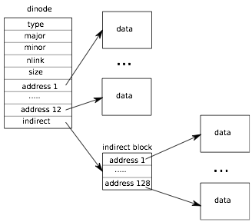
i-node Content

Slide 113
i-node Content
Note that there's only one level of indirection here
So there is a maximum file size: (number of direct blocks + number of indirect blocks) x blocksize = (12 + 128) x 512 bytes = 70 KB

Slide 114
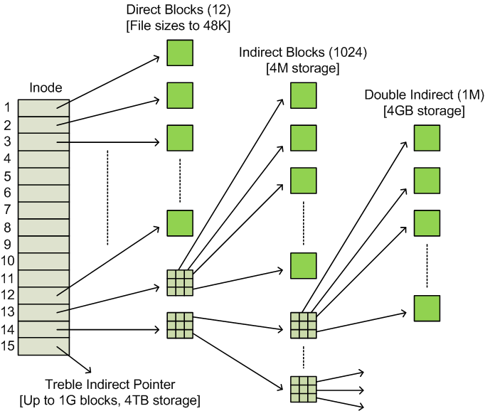
ext3 i-nodes

Slide 115
xv6 Directories
File & directory names are limited to 14 characters
Directories are just another kind of file, whose content is a list of struct dirents
// Directory is a file containing a
// sequence of dirent structures.
#define DIRSIZ 14
struct dirent {
ushort inum;
char name[DIRSIZ];
};

Slide 116
Directory Lookup
// Look for a directory entry in a directory.
// If found, set *poff to byte offset of entry.
struct inode*
dirlookup(struct inode *dp, char *name, uint *poff)
{
uint off, inum;
struct dirent de;
if(dp->type != T_DIR)
panic("dirlookup not DIR");
for(off = 0; off < dp->size; off += sizeof(de)){
if(readi(dp, (char*)&de, off, sizeof(de)) != sizeof(de))
panic("dirlink read");
if(de.inum == 0)
continue;
if(namecmp(name, de.name) == 0){
// entry matches path element
if(poff)
*poff = off;
inum = de.inum;
return iget(dp->dev, inum);
}
}
return 0;
}

Slide 117
Avoiding Deadlock
The reason iget and ilock are separate functions is to help avoid deadlock
In dirlookup, what happens if the thing we're looking up is "." ?
The caller has locked the directory inode
Dirlookup doesn't want it to be evicted from the cache
But "." refers to the current directory, so attempting to lock it will cause a deadlock
Solution: separate out acquisition and locking

Slide 118
Real World Filesystems
Buffer caches can use more sophisticated eviction policies for particular workloads
Logging can be made more efficient:
Don't log entire blocks (only a few bytes may have changed)
Allow filesystem calls to happen at the same time as a commit is taking place
Use better data structures (e.g., balanced tree) for directories to avoid linear scan

